Slide 2
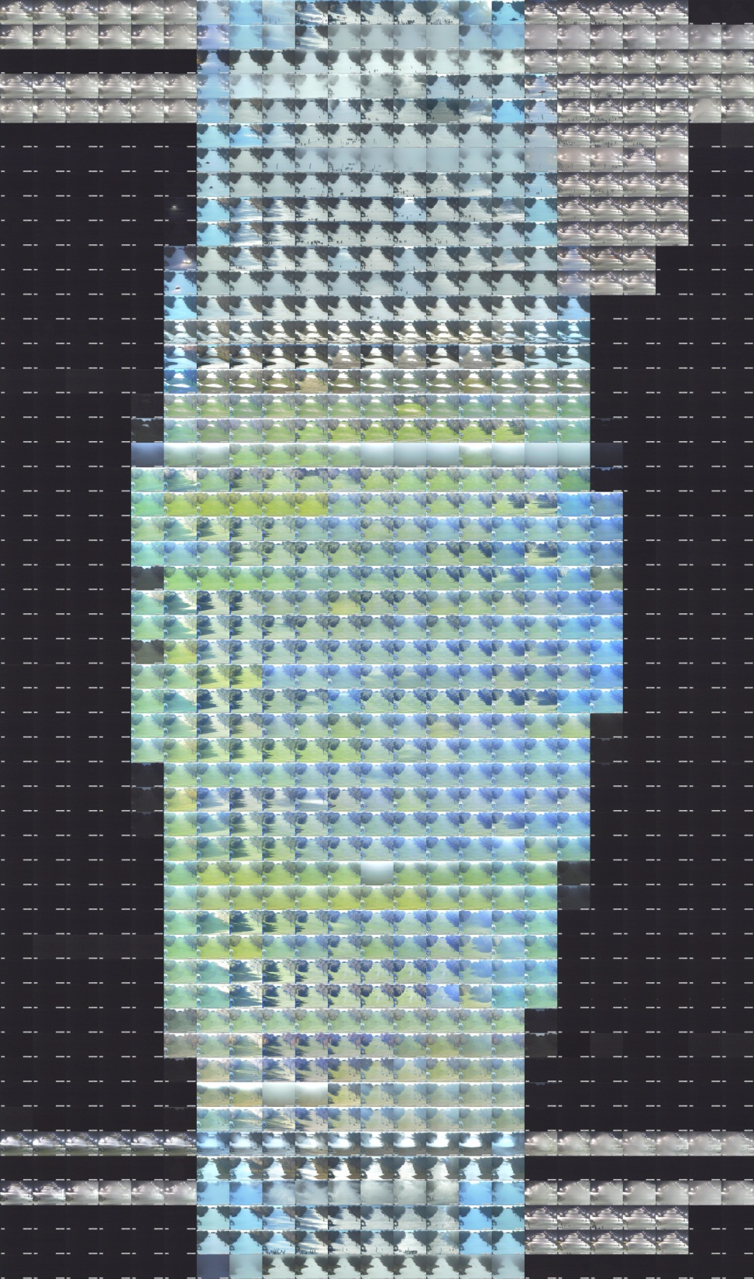
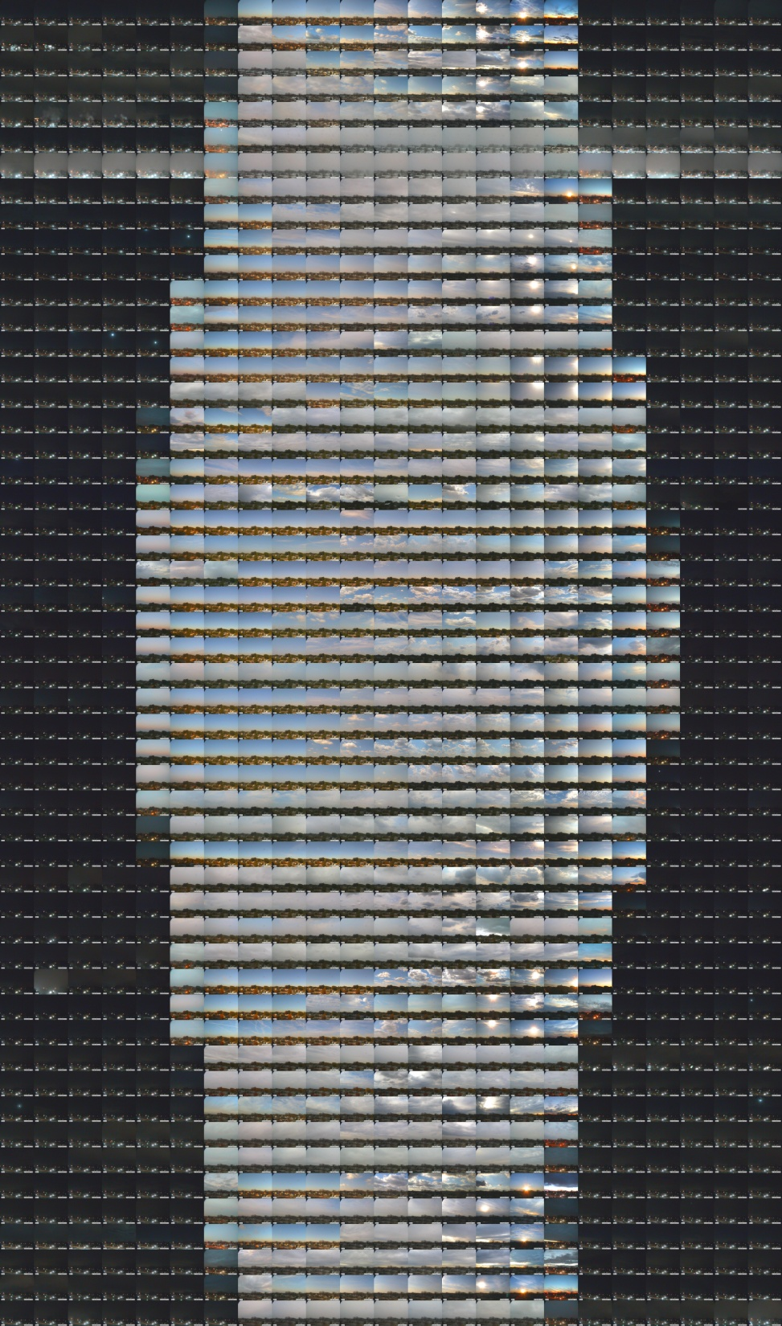

Slide 3
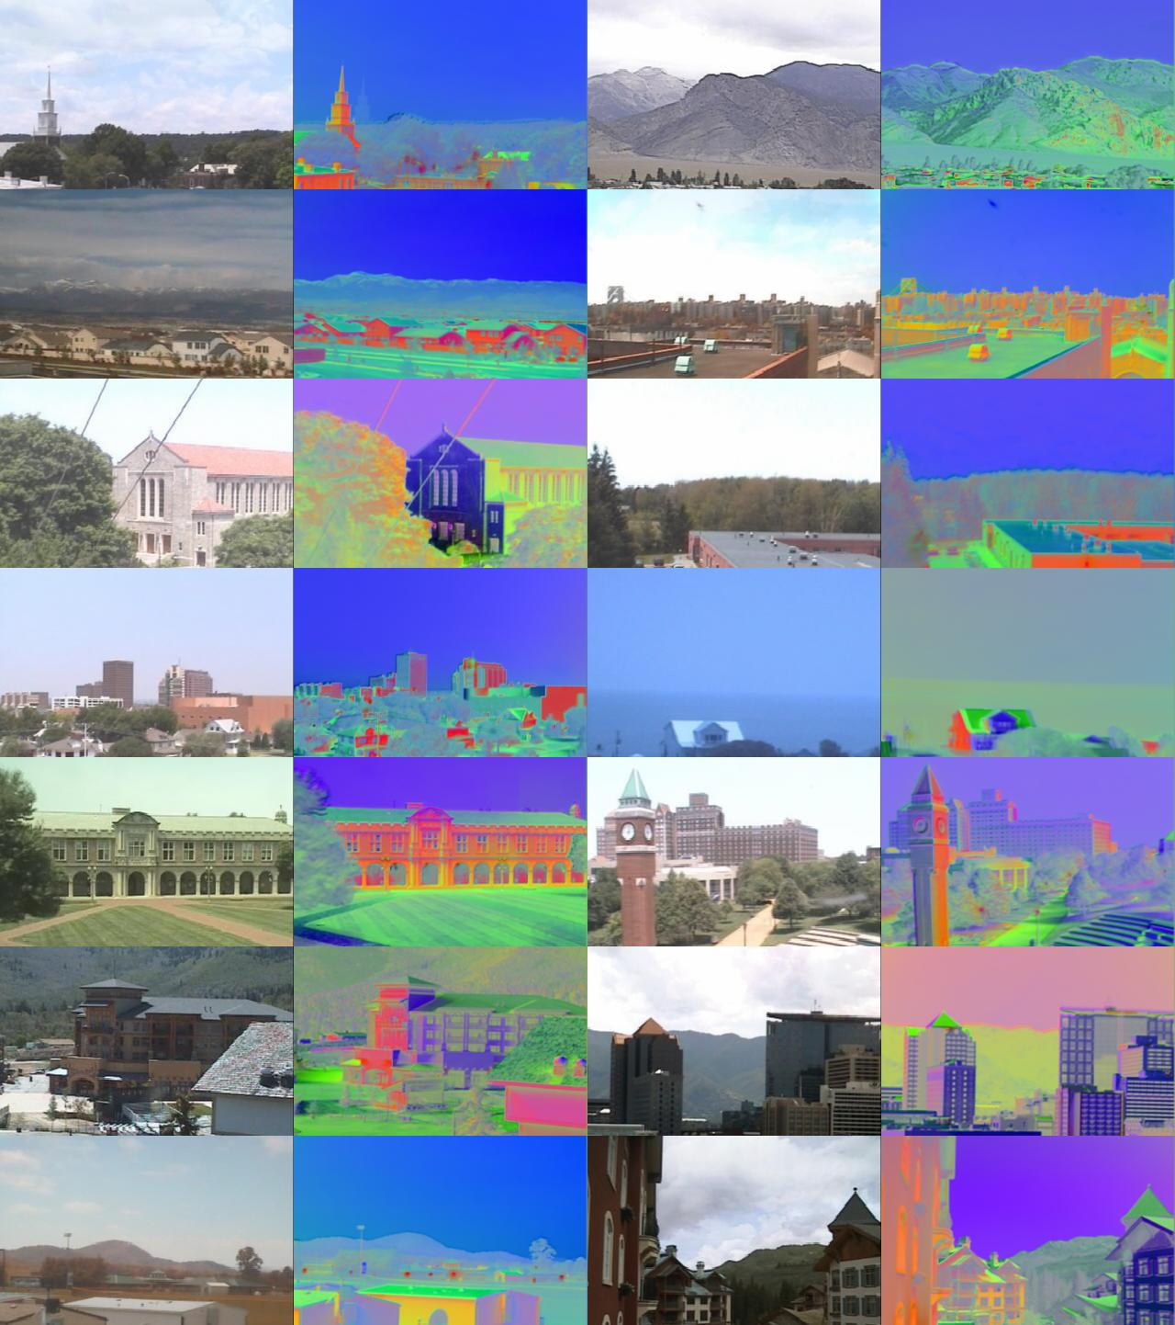
Canonical Day Components
“Consistent Temporal Variations in Many Outdoor Scenes”
Jacobs, Roman, Pless, CVPR 2007

Slide 4
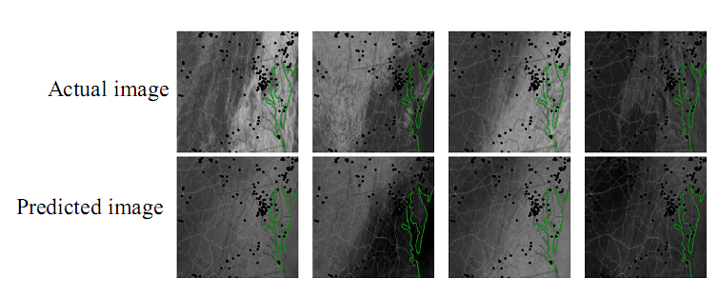
Predicting satellite images from webcams

Slide 5
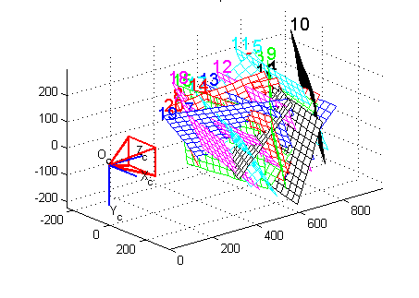
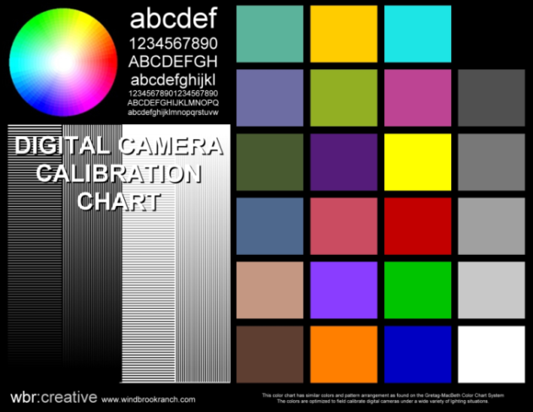
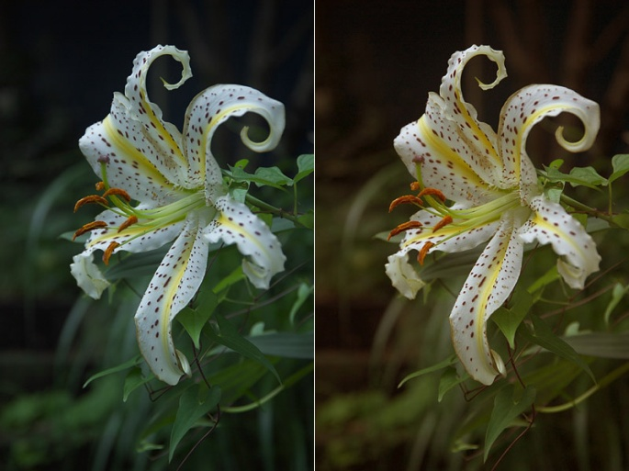
camera calibration
Bouguet

Slide 6
segue
Robert’s talk:
Let’s use webcams for science.
Nathan’s talk:
Let’s learn some things about the camera first.

Slide 7
Related Work
WILD database
All the Images of an Outdoor Scene, Narasimhan, Wang, Nayar, ECCV 2002
“Clustering Appearance for Scene Analysis”, Koppal, Narasimhan, CVPR 2006
Time Lapse
Factored Time-Lapse Video, Sunkavalli, Matusik, Pfister, Rusinkiewicz, SIGGRAPH 2007.
What do Color Changes Reveal about an Outdoor Scene?, Sunkavalli, Romeiro, Matusik, Zickler, Pfister, CVPR 2008
Radiometric Calibration with Illumination Change for Outdoor Scene Analysis, Kim, Frahm, Pollefeys, CVPR 2008.

Slide 8
Relative Camera Localization
The linear relationship between distance and canonical correlation.

